Slide 1
TABLE OF CONTENTS
01
INTRODUCTION
02
DATASET & DESCRIPTION
03
Q&A
04
LEARNING OUTCOMES

Slide 2
PROJECT ~ 1
Disease
Prediction
By Mithil Nagaonkar

Slide 3
TABLE OF CONTENTS
01
INTRODUCTION
02
DATASET & DESCRIPTION
03
Q&A
04
LEARNING OUTCOMES

Slide 4
INTRODUCTION
01

Slide 5
Overview:
Healthcare professionals often rely on various diagnostic tests and biomarkers to assess an individual's health status and diagnose diseases. In this scenario, we have access to a dataset containing multiple health-related attributes such as cholesterol levels, blood cell counts, hormone levels, and other physiological measurements. The dataset also includes information on whether the individual has been diagnosed with a specific disease or not..
Objective :
Healthcare professionals often rely on various diagnostic tests and biomarkers to assess an individual's health status and diagnose diseases. In this scenario, we have access to a dataset containing multiple health-related attributes such as cholesterol levels, blood cell counts, hormone levels, and other physiological measurements. The dataset also includes information on whether the individual has been diagnosed with a specific disease or not.

Slide 6
DATASET & DESCRIPTION
02

Slide 7
The dataset consists of the following attributes:
Cholesterol: Level of cholesterol in the blood (mg/dL)
Haemoglobin: Protein in red blood cells carrying oxygen
Platelets: Blood cells aiding in clotting
White Blood Cells (WBC): Immune system cells fighting infections
Red Blood Cells (RBC): Cells carrying oxygen
Haematocrit: Percentage of blood volume occupied by RBC
Mean Corpuscular Volume (MCV): Average volume of RBC
Mean Corpuscular Haemoglobin (MCH): Average amount of haemoglobin in RBC
Mean Corpuscular Haemoglobin Concentration (MCHC): Average concentration of haemoglobin in RBC
Insulin: Hormone regulating blood sugar levels
BMI (Body Mass Index): Measure of body fat based on height and weight
Systolic Blood Pressure (SBP): Pressure in arteries during heartbeats
Diastolic Blood Pressure (DBP): Pressure in arteries at rest between beats
Triglycerides: Type of fat found in blood (mg/dL)
HbA1c (Glycated Haemoglobin): Measure of average blood sugar levels over past 2-3 months
LDL (Low-Density Lipoprotein) Cholesterol: "Bad" cholesterol
HDL (High-Density Lipoprotein) Cholesterol: "Good" cholesterol
ALT (Alanine Aminotransferase): Liver enzyme
AST (Aspartate Aminotransferase): Enzyme found in liver and heart
Heart Rate: Number of heartbeats per minute (bpm)
Creatinine: Waste product produced by muscles and filtered by kidneys
Troponin: Protein released into bloodstream during heart muscle damage
C-reactive Protein (CRP): Marker of inflammation in the body
Disease: Binary indicator (1: Diseased, 0: Non-diseased)

Slide 8
Questions & Answers
03

Slide 9
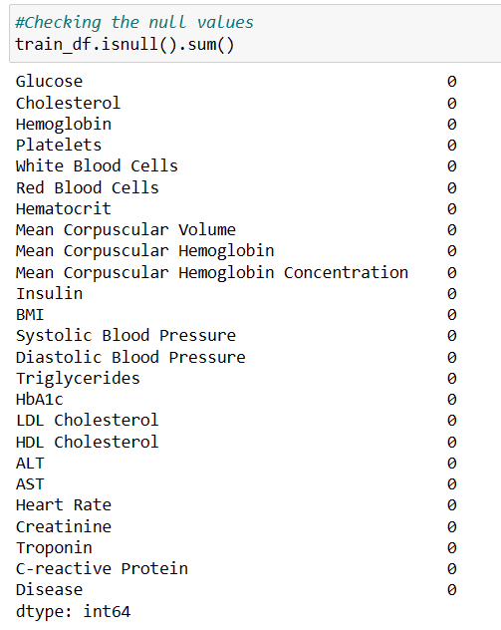
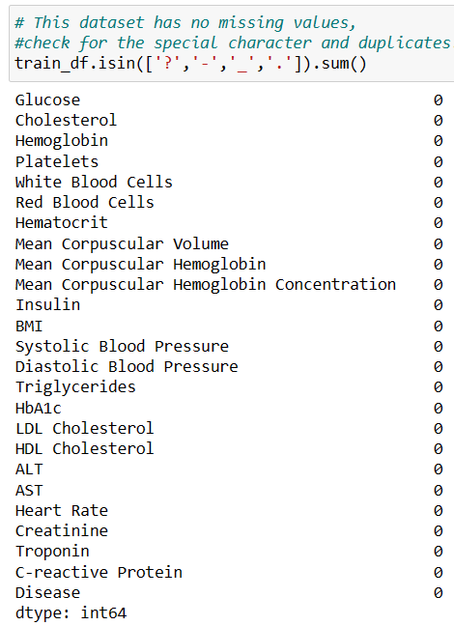
Q1. Write a code to check NULL values and duplicate values

Slide 10
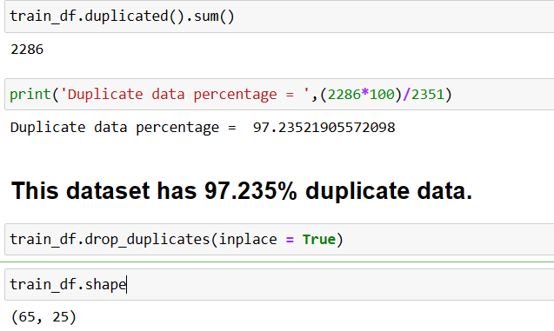
Q1. Write a code to check NULL values and duplicate values

Slide 11

Q2. Heatmap code to see the Correlation

Slide 12
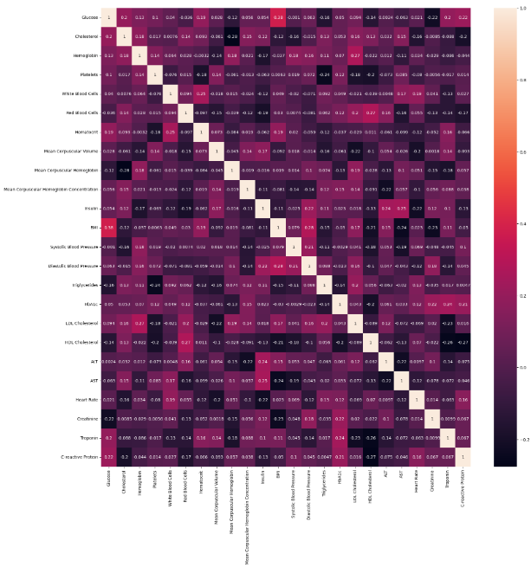
Heatmap

Slide 13
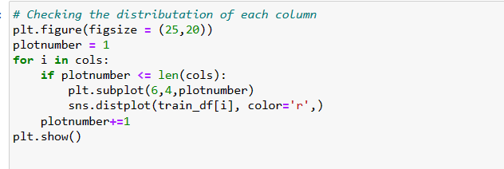
Q3. Check the Distribution of the columns
Code :

Slide 14
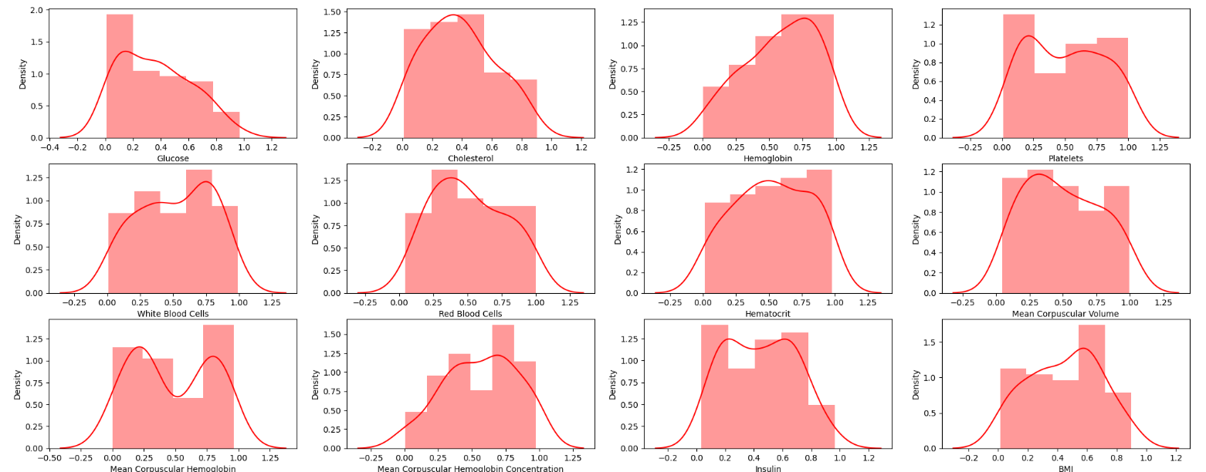
Q3. Check the Distribution of the columns

Slide 15
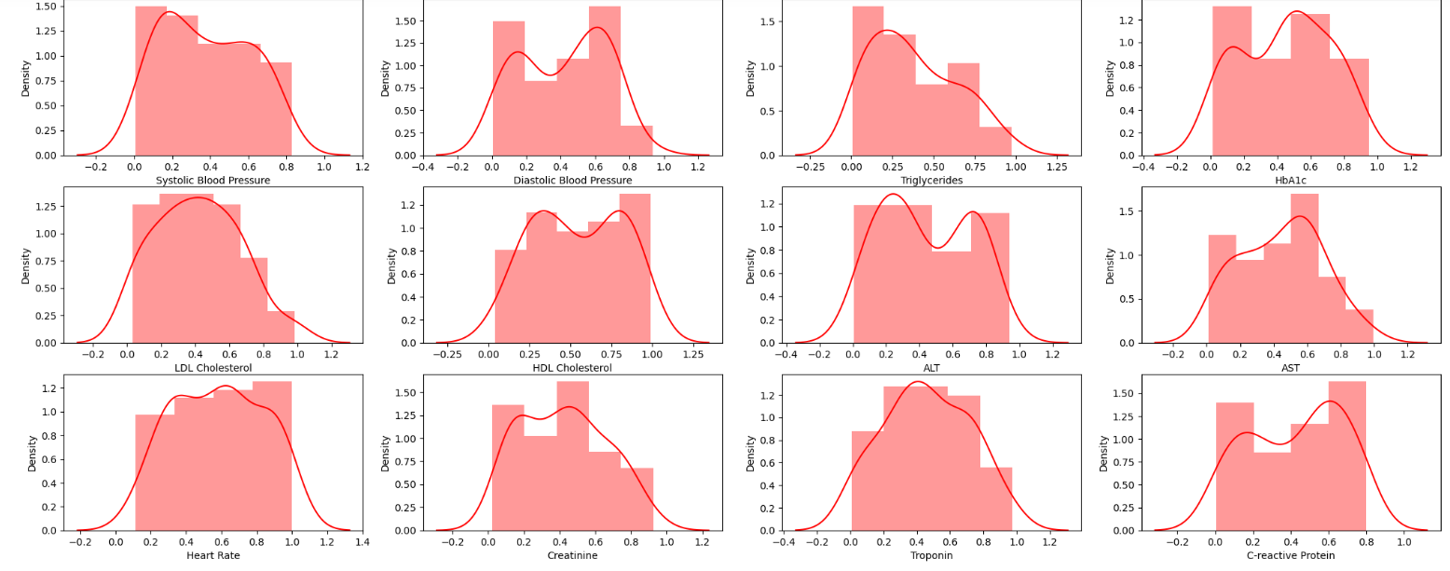
Q3. Check the Distribution of the columns

Slide 16
Observation :
Form the graphs we can say that our data is sort of normally distributed

Slide 17
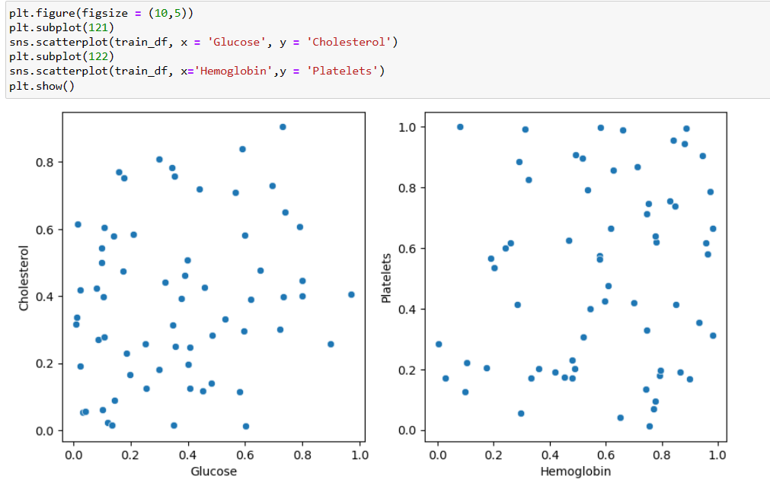
Q5. Scatterplot to see the relation

Slide 18
Observation :
There is no any relation between the columns

Slide 19
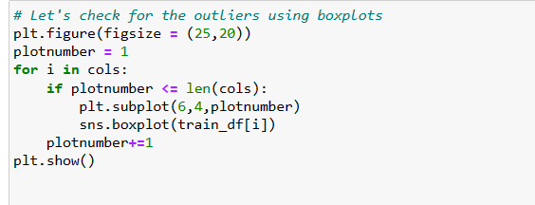
Q6. Boxplot to see the Outliers in the dataset
Code :

Slide 20
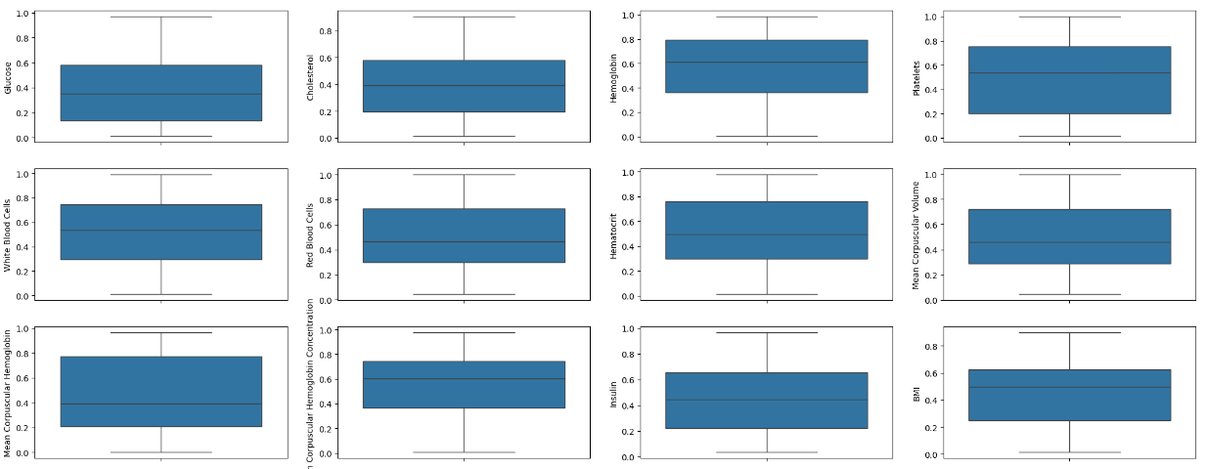
Q6. Boxplot to see the Outliers in the dataset

Slide 21
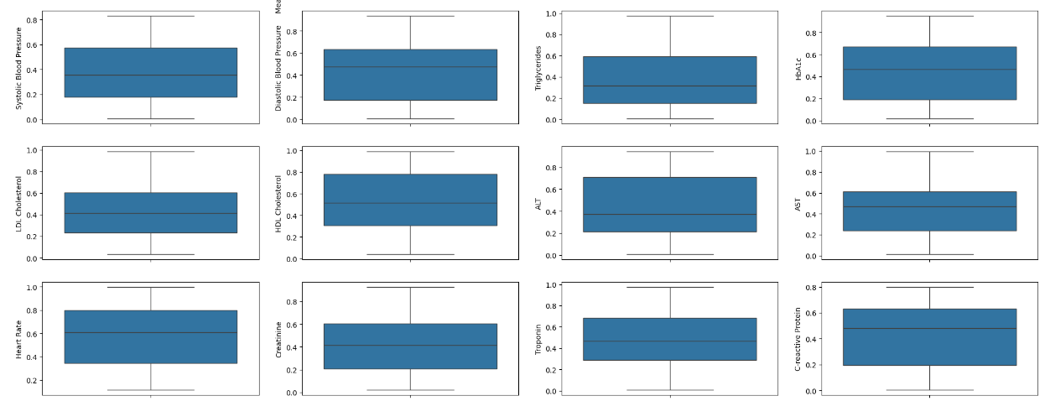
Q6. Boxplot to see the Outliers in the dataset

Slide 22
Observation:
No Outliers in the dataset

Slide 23
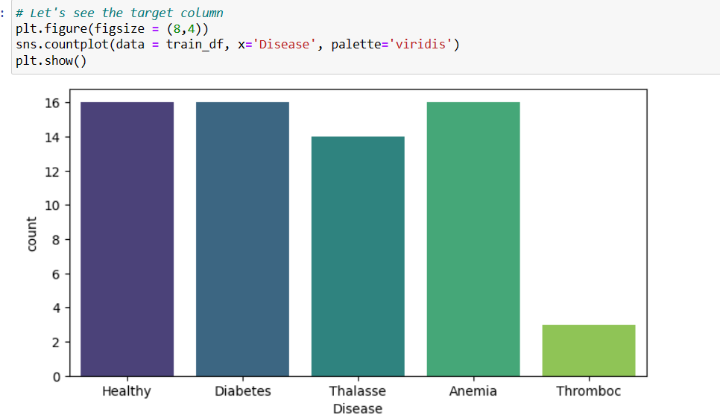
Q8.Analysing target column

Slide 24
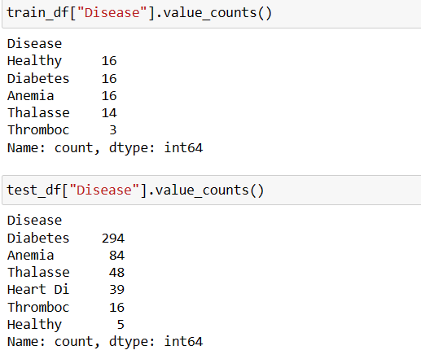
Observation :

Slide 25
Problem :
We have one extra category into the test data which is Heart Di.
Extra category into the test dataset can create the problem while transforming and model prediction
Solution :
we can make 2 decisions :
We remove this Extra category('Heart Di) and work with other categories
Or We can simply make only two categories (1: Diseased(Diabetes, Anemia, Thalassa, Heart Di, Thrombus), 0: Non-diseased(Healthy)

Slide 26
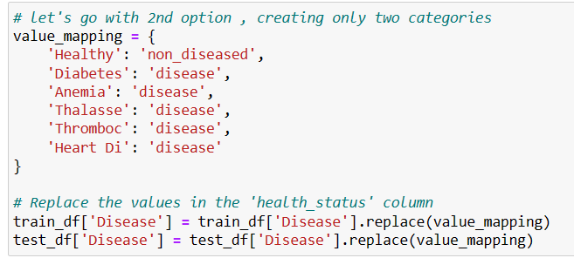
Q9.Going with 2nd option, creating only two categories
Code:

Slide 27
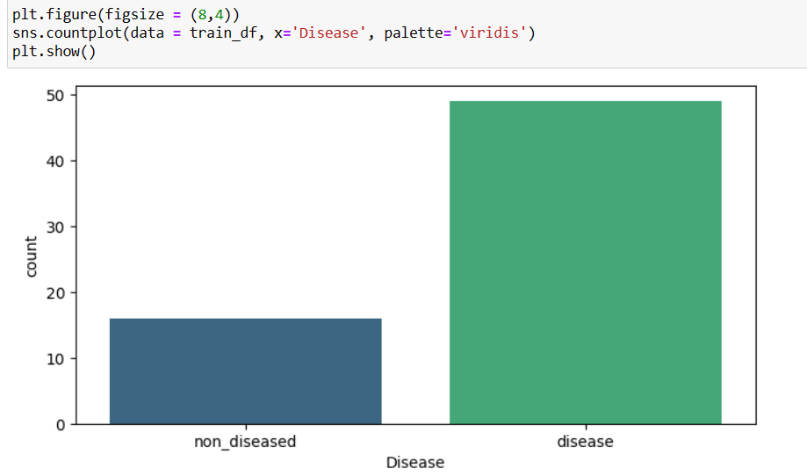
Categories after replacing

Slide 28
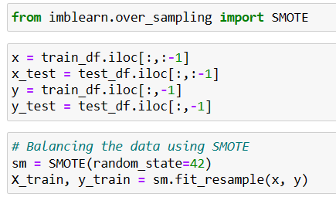
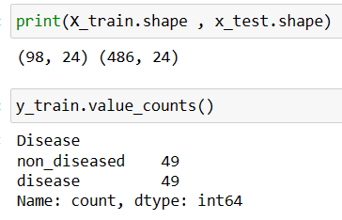
Q10. Handling imbalanced data using SMOTE
Code :
Output :

Slide 29
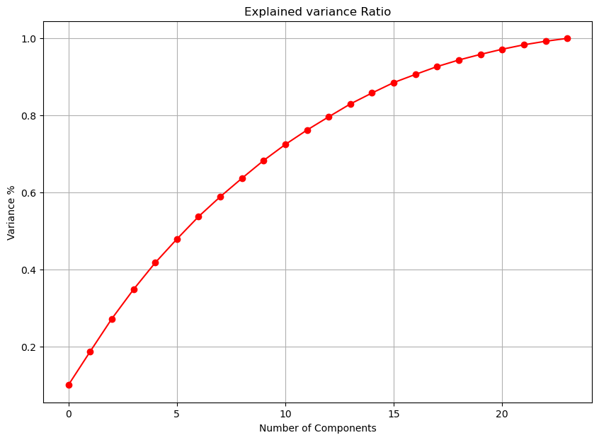
Q11. PCA

Slide 30
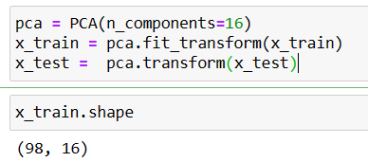
Observation :
AS per the graph, we can see that 16 principal components attribute for 90% of variation in the data. We shall pick the first 16 components for our prediction
Output :

Slide 31
Q12. What are the ML models we used
DecisionTreeClassifier = DecisionTreeClassifier()
RandomForestClassifier = RandomForestClassifier()
LogisticRegression = LogisticRegression()
SVC = SVC()
GaussianNB = GaussianNB()
KNeighborsClassifier = KNeighborsClassifier()
ExtraTreesClassifier = ExtraTreesClassifier()
GradientBoostingClassifier=GradientBoostingClassifier()

Slide 32
LEARNING OUTCOMES
04

Slide 33




Data Quality AssuranceData Cleaning
Checking NULL and Duplicated values ,Dropped duplicate records, we can learn the importance of data quality assurance techniques and how to handle missing or duplicate data in dataset.
Data Cleaning
Examining the distribution and the relation of the columns & the outliers in the dataset. Handling imbalanced data using SMOTE technique.
Feature Engineering
Feature Engineering
Data separation ,Data Scaling, multicollinearity in the dataset using VIF, Dimensionality reduction using PCA implementation.
Feature Selection

Slide 34
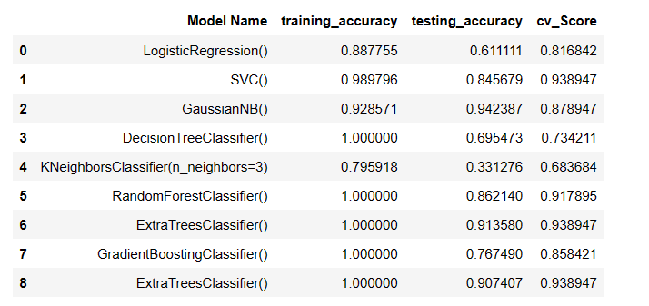
Model Training and final output

Slide 35
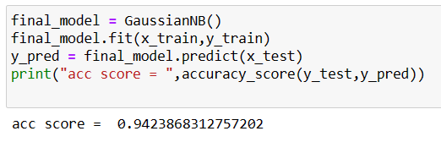
Performance and Accuracy Score

Slide 36
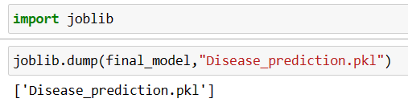
Observation :
The GaussianNB() model seems to generalize well.
Saving the final model :

Slide 37


Thank You
DO YOU HAVE ANY QUESTIONS?
mithil.nagaonkar01@gmail.com

